Slide 1
Header
logo, does not link to anything
nav bar, link to different pages within this web site
create breadcrumb by adjust it to each pages’ layout and structure
Single html file for header, and use J-Query to put on every pages. *bredcrumb is not part of this

Slide 2
Footer
SNS/YouTube links with icon button. User can jump to SNS/YouTube page
nav bar for footer. same as header nav
basic info about publisher
contact info, user can easily send email or call by clicking them
JavaScript animation button, you can change the color of footer’s text. This image is in default.
single HTML file for footer as same way as header (J-Query)

Slide 3

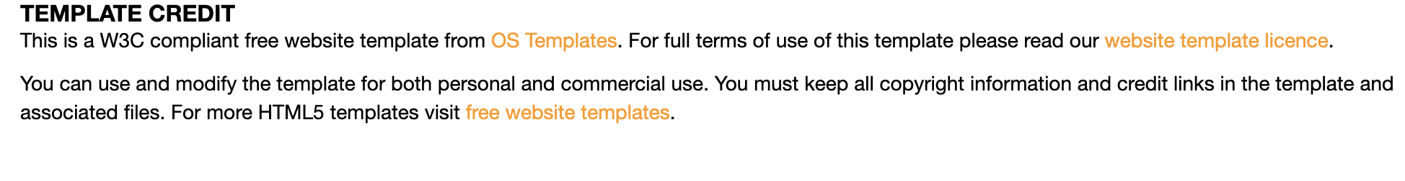
Computer science topic page
topic introduction/title
preview of each article and link to it
for user to reach to more articles
template credit of open source

Slide 4
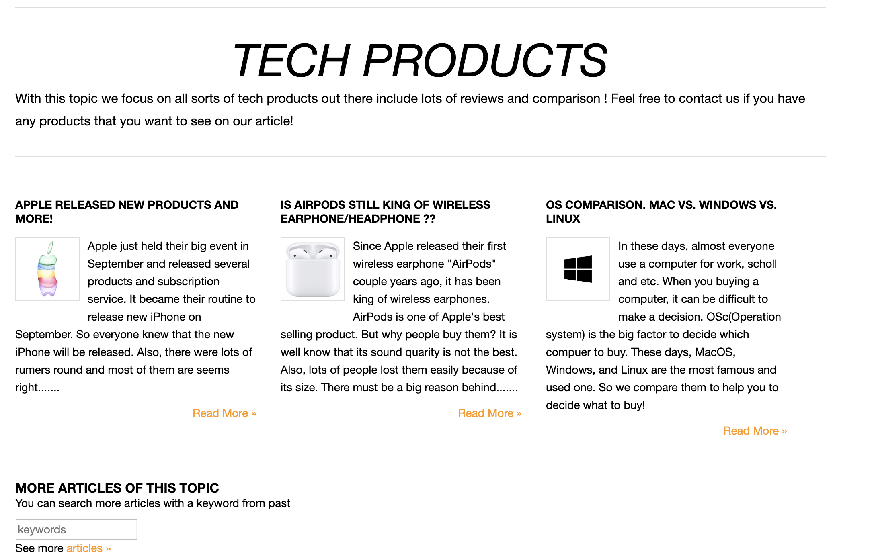
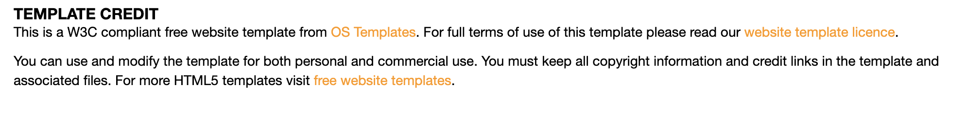
Tech Product topic page
This page has exactly same structure and function as Computer Science topic page. Just different contents

Slide 5
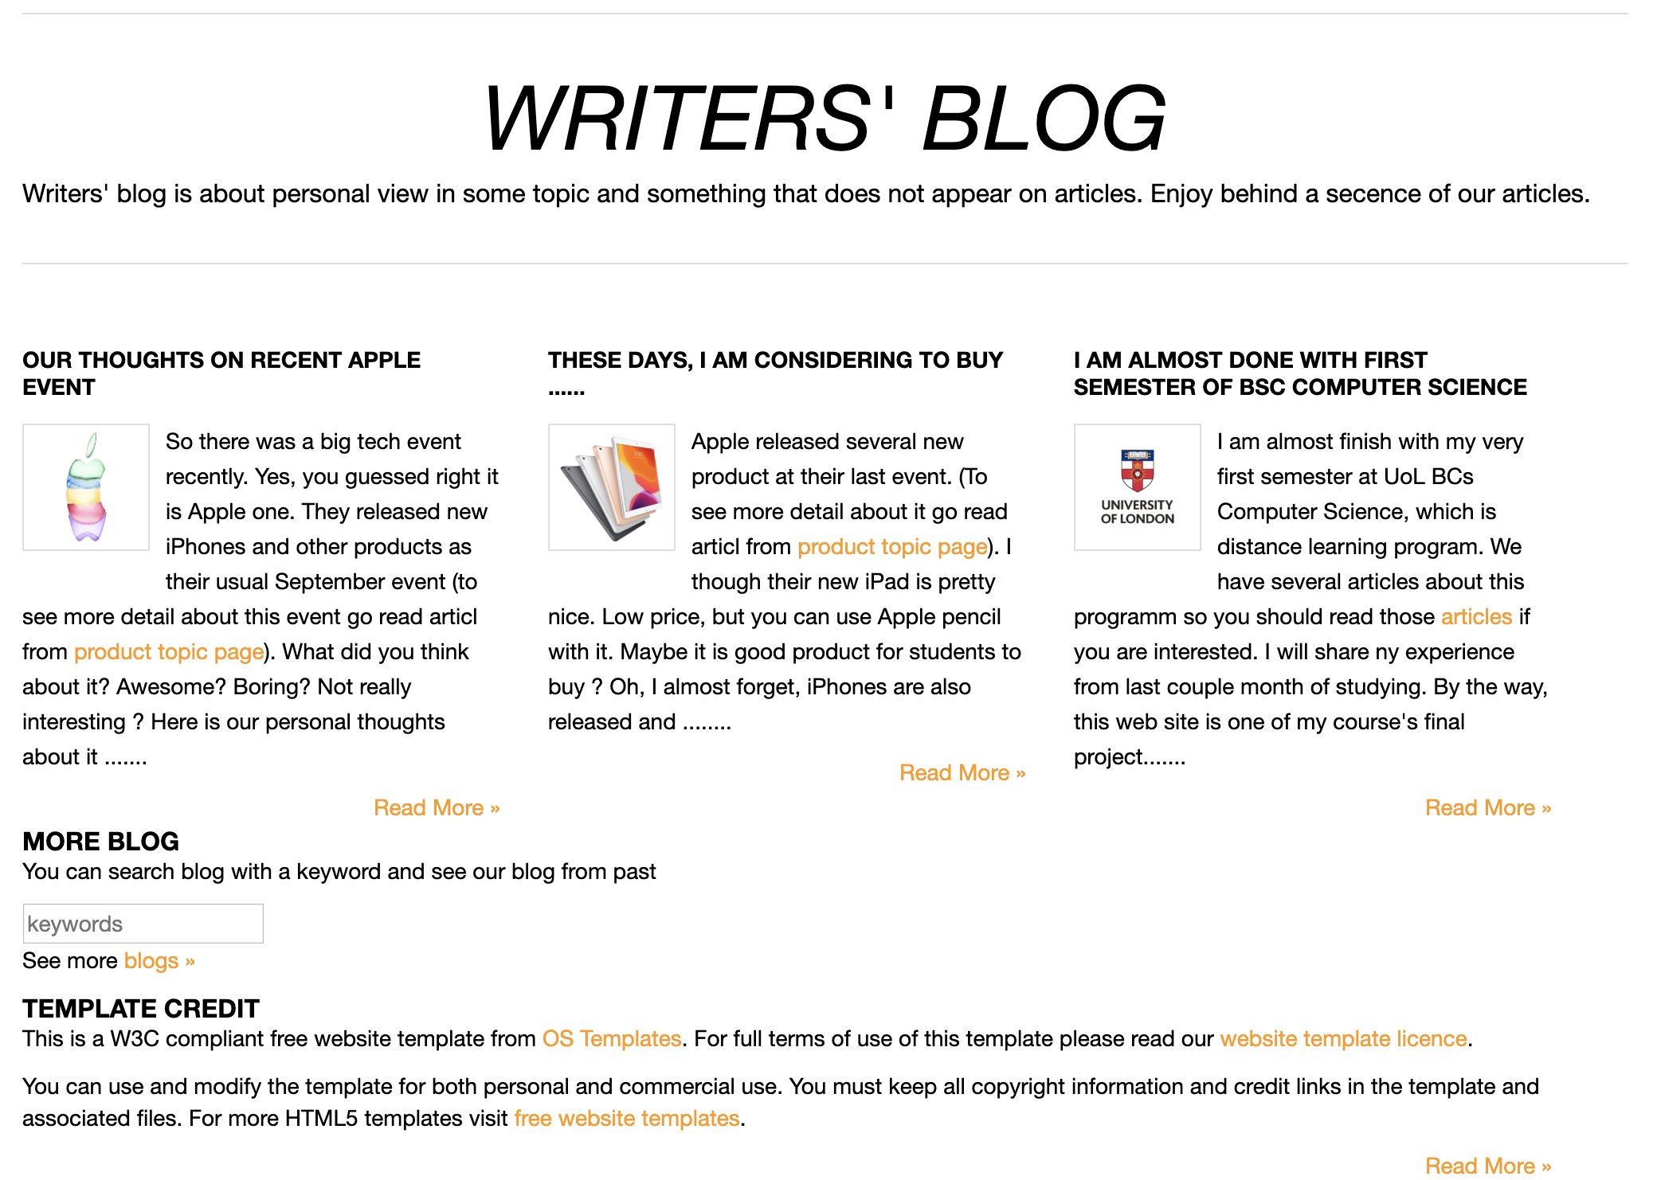
Blog page
This page has exactly same structure and function as Computer Science topic page. Just different contents

Slide 6

Subscription topic page
title of this page
link to sing-up form
main contents of this page
link to login page
contents continue below, with same format

Slide 7

Article pages
title
article can contain some link to other web site and etc
article with text and images
all article pages has same structure and function, but different contents

Slide 8
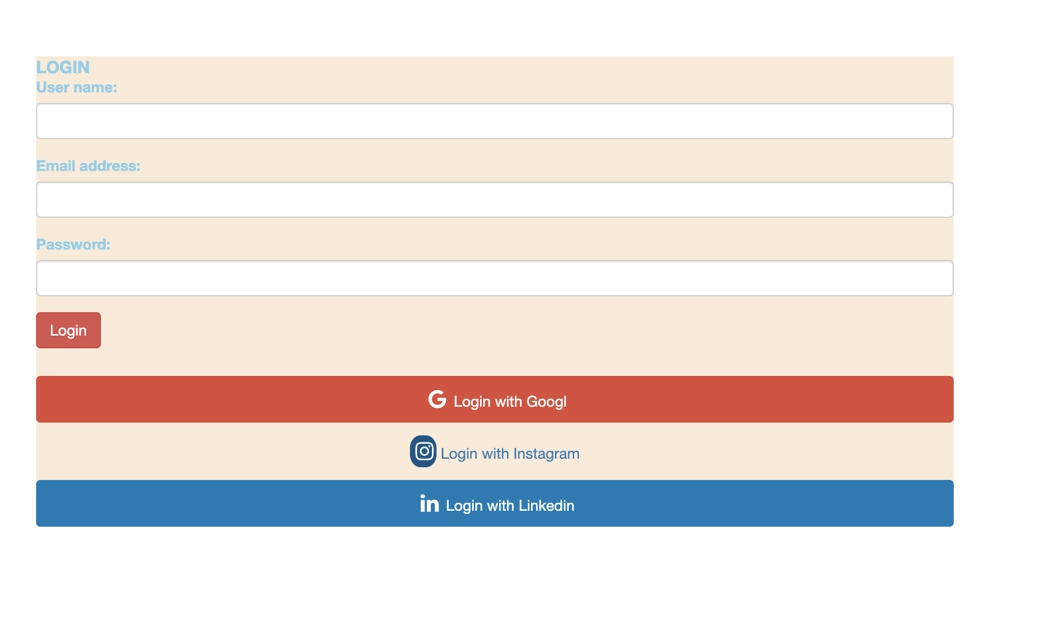
Login page
user input for their login info
user also can login with other web site info, if they singed up with it

Slide 9
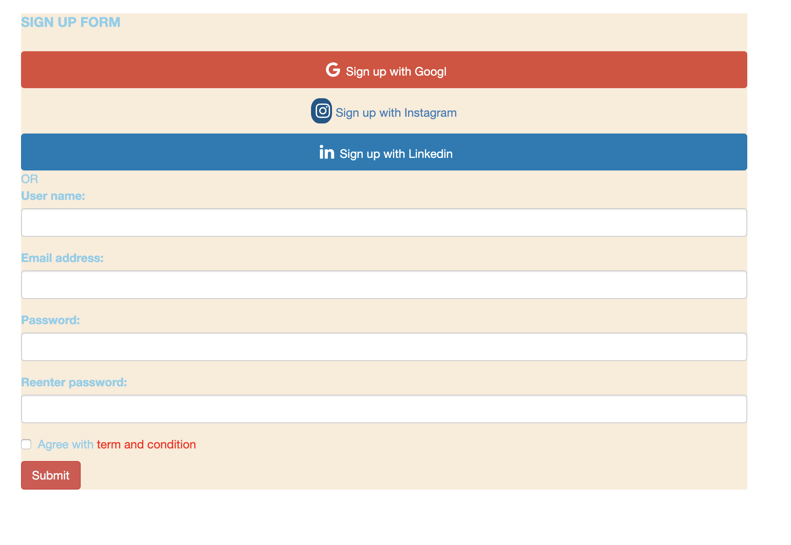
Sign-up page
to sign-up with other web site account
user input for their general info
to red term and condition and agree to it

